Slide 1
COMPLETE INTRODUCTION TO AWS
Santosh Kumar
Firstman Tech
Vizag

Slide 2
AWS History
Internally launched on 2002
Idea to set AWS to launch publicly on 2003
Amazon Simple Queue Service(SQS) or Message Queuing service launch on 2004.
Upgraded with S3, SQS and EC2 in 2006.
All amazon.com retail services migrated to AWS on 2010.
Revenue of $25 billion in 2018.

Slide 3
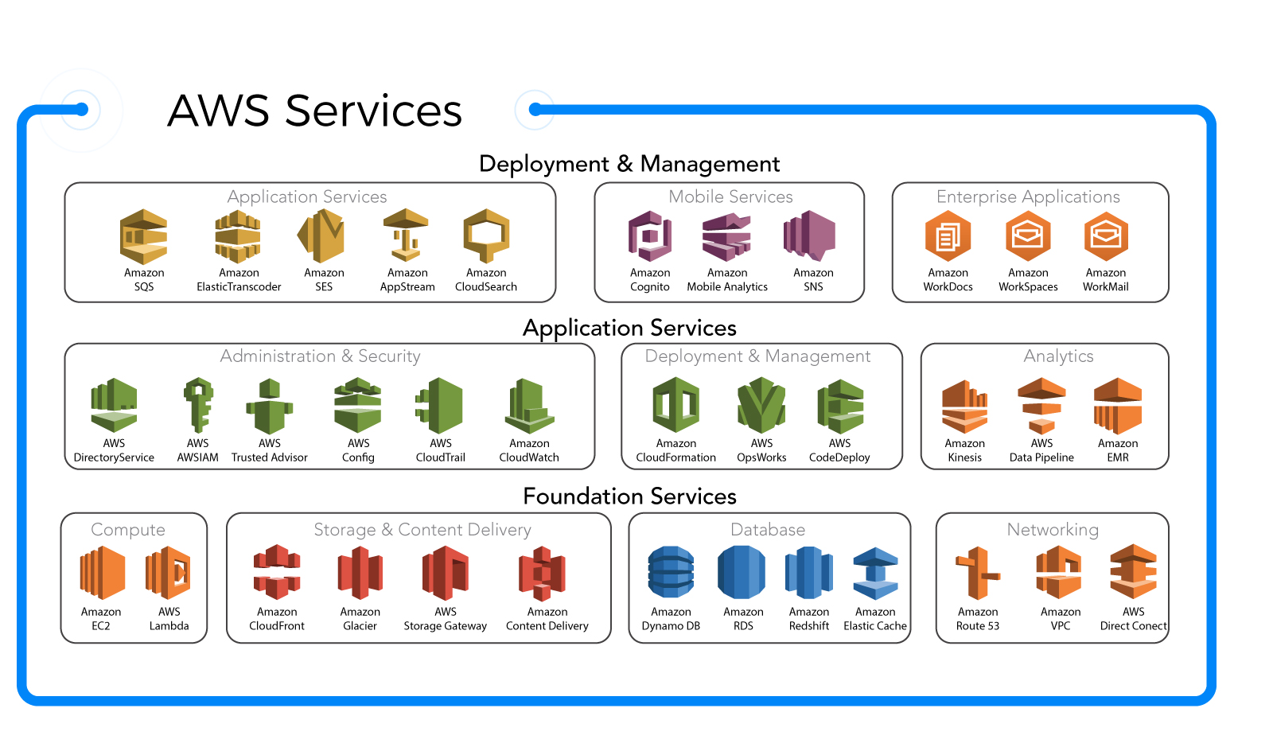

Slide 4
Why should I learn AWS
Security:
AWS Cloud Services provides real time security for small scale and as well for large scale applications.
Compliance Programs: Helps you provide your security better by abiding laws, rules and regulations of the company.

Slide 5
API
Support for various programming languages.
Launch Instances
Take backups

Slide 6
Recovery
Versatile Recovery by various Recovery Tools.

Slide 7
Customization
AWS provides various features to customize your application.
Tagging features or User defined tags support to monitor your resources.
Can Track your costs.

Slide 8
Automated Scheduling
Services like EC2 and RDS will give the feature to automatically schedule an instance like server to stop or start etc…
Third party tools which will help you eliminate coding.
Detect downtime or low-traffic.

Slide 9
Consistence and Reliability
AWS is best for backups and disaster recovery.
Less downtime.

